Slide 1
Year 9 GCSE Parent Information Evening
Helping you achieve the future you deserve
“Fail to prepare; prepare to fail!”

Slide 2

Why are we here?
What do I need to do to ensure success in year 9?
When and why?
Thursday 28th Sept – 5pm – 7pm
Ensure success for your child
Gain information on any current changes to GCSE/BTEC courses
Find key strategies to enable home support in partnership with the academy
"Take action today to improve tomorrow"
“Fail to prepare; prepare to fail!”

Slide 3
How will success be measured in 2020?
Your top eight subjects will be divided into ten blocks with Maths and English counting twice each:
Maths | Maths | English | English | Ebacc 1 | Ebacc 2 | Ebacc 3 | Other Ebacc, BTEC or GCSE 1 | Other Ebacc, BTEC or GCSE 2 | Other Ebacc, BTEC or GCSE 3
Result for GCSE: Maths |  | Best result between GCSE: English Language English Literature |  | Best three results from the following Ebacc GCSE: Spanish French Physics Chemistry Biology Computer Science Core Science Additional Science History Geography GCSE *Ancient or Modern *Home Language Ebacc – From the list of English Baccalaureate GCSE subjects |  |  | Best three results for any GCSE or level 2 qualification (examples below): BTEC Health and social care Hairdressing college course Any other GCSE such as business, media, drama, PE, art…

Slide 4
Your grades in 2020?
Subjects will now convert to the 9-1 grade system as they are superseded with new specifications from 2019. This is an example result set:
Maths | Maths | English | English | Ebacc 1 | Ebacc 2 | Ebacc 3 | Other Ebacc, BTEC or GCSE 1 | Other Ebacc, BTEC or GCSE 2 | Other Ebacc, BTEC or GCSE 3
Result from: Grade 5 - Maths |  | Best result from GCSE: 4 - English Lang 5 - English Lit |  | Best three results from the following Ebacc GCSE: 7 - Spanish 4 - Physics 6 - Chemistry 5 - Biology 5 – Computer Science 6 - History |  |  | Best three results for any GCSE or level 2 qualification: 6 - Design Technology 4 - GCSE RE

Slide 5
How your grades will count in 2020?
The highest grades achieved in each block are allocated. Notice that English Language and Computing can count in the last block as they are the best results:
Maths | Maths | English | English | Ebacc 1 | Ebacc 2 | Ebacc 3 | Other Ebacc, BTEC or GCSE 1 | Other Ebacc, BTEC or GCSE 2 | Other Ebacc, BTEC or GCSE 3
Result is doubled: 5 - Maths |  | Best result is doubled: 5 - English Lang 6 - English Lit |  | Best three results from the following Ebacc GCSE: 7 - Spanish 4 - Physics 6 - Chemistry 4 - Biology 5 – Computer Science 5 - History |  |  | Best three results for any GCSE or level 2 qualification: 7 - Design Technology 4 - GCSE RE
5 Maths | 5 Maths | 6 Eng Lit | 6 Eng Lit | 7 Spanish | 6 Chem | 5 History | 7 DT | 5 English Lang | 5 Comp.

Slide 6
Attainment 8 and Progress 8 in 2019?

Slide 7
What is key?
I need to ensure success:
Literacy
Numeracy
Resilience
Aspirations
Attendance
Focus
What things can I do to make sure I achieve my potential?
"Take action today to improve tomorrow"
“Fail to prepare; prepare to fail!”

Slide 8
What is preparation?
It means actively looking over work on
an ongoing basis:
To remind you of things you have forgotten
To make links with other learning so you have the bigger picture
To reinforce learning
To identify what you don’t know
To check understanding
I’ve read all my notes but I can’t remember any of it!
"Take action today to improve tomorrow"
“Fail to prepare; prepare to fail!”

Slide 9
Why prepare?
It reduces panic – gives you control and confidence
It means that exams reflect what you can do, not what you didn’t bother to do!!
It can help identify problem areas
Achieve better results!
Think about what your subjects are about, what you have to do in them,
what you feel confident/ less confident about. Talking about your
learning with others will help you to think about your learning needs.
"Take action today to improve tomorrow"
“Fail to prepare; prepare to fail!”

Slide 10
Where to start? When to prepare?
Work out how much time you have – being realistic
Don’t forget to factor in a bit of play time also!
Take into account your ideal time of day to work – work out when you will revise
Break it down into manageable “chunks” e.g. ‘revising French verbs’ sounds more manageable than ‘revising for GCSEs’
Make sure you use your planner/timetable to keep up with revision and
encourage yourself to attend revision sessions outside school hours where offered
"Take action today to improve tomorrow"
“Fail to prepare; prepare to fail!”

Slide 11

Getting organised....
"Take action today to improve tomorrow"
“Fail to prepare; prepare to fail!”

Slide 12
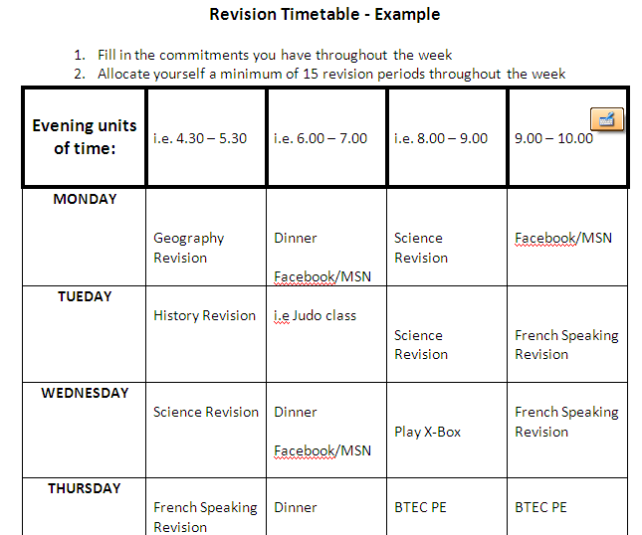
Revision Timetable
"Take action today to improve tomorrow"
“Fail to prepare; prepare to fail!”

Slide 13
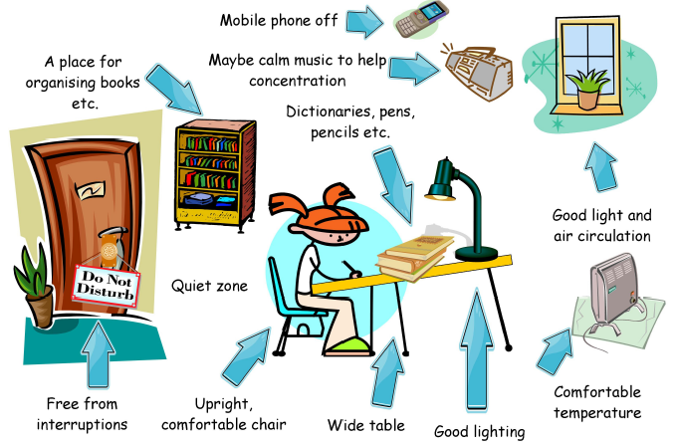
Ideal revision area..
"Take action today to improve tomorrow"
“Fail to prepare; prepare to fail!”

Slide 14

What resources do you need to prepare?
Ensure you have the right resources to revise actively:
  Pens, rulers, pencils, paper, glue, scissors
  Post-it notes
  Coloured pens
  Highlighters
  Dictionary
  Revision guides, CDs & Podcasts
  Food and drink!!!
"Take action today to improve tomorrow"
“Fail to prepare; prepare to fail!”

Slide 15
What and how should you prepare?
Do you know what you need to do?
  What will actually be tested on the course OR in the exam? (Revision list)
  What date is the coursework / exam? (Exam timetable)
  When does the exam start and how long is it?
Do you have the materials to do it?
  Exercise books, textbooks, folders,
  Revision guides
  Access to internet (websites)
If there are any gaps in your learning then ask your teacher….
"Take action today to improve tomorrow"
“Fail to prepare; prepare to fail!”

Slide 16
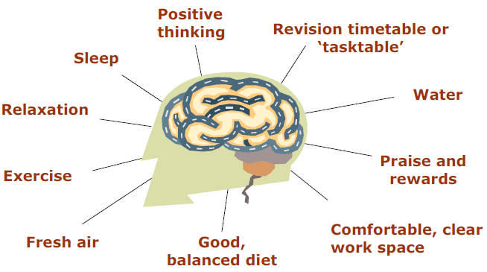
10 ways to keep the brain happy (& productive!)
"Take action today to improve tomorrow"
“Fail to prepare; prepare to fail!”

Slide 17
How long should you revise for?
Take breaks……you will remember more!
Learning
Break time!
Break time!
Break time!
Break time!
1
2
3
4
"Take action today to improve tomorrow"
Time (hours)
“Fail to prepare; prepare to fail!”

Slide 18
Final pieces of advice...
Be positive about your attempts. Make an appointment with subject teachers if you are concerned about your progress
Be patient! Become an independent learner. Look up information or find a word in a dictionary rather than simply ask someone for the answer in order to get the task finished
Turn off the television while revision is underway, but do listen to music if you find it helpful
Agree a place and a time for help – listening to your friends and sharing your knowledge is important if you ALL want to achieve success
"Take action today to improve tomorrow"
“Fail to prepare; prepare to fail!”

Slide 19
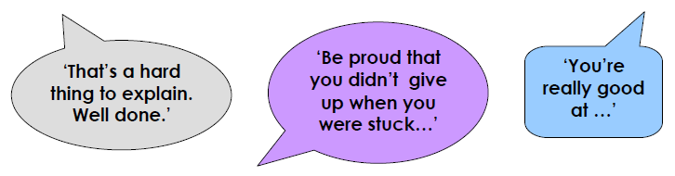
More advice....
It doesn’t need to be a marathon session; little and often is usually best
Recognise your own emotional state - if you are tense or worrying about something else, it might not be a good time to work
Don’t be afraid to STOP if it isn’t going well. Try to agree what the difficulty is and when to come back later with fresh eyes
ALWAYS end with a positive (make yourself feel good)
"Take action today to improve tomorrow"

Slide 20


Slide 21
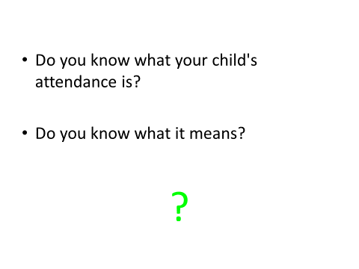

Slide 22
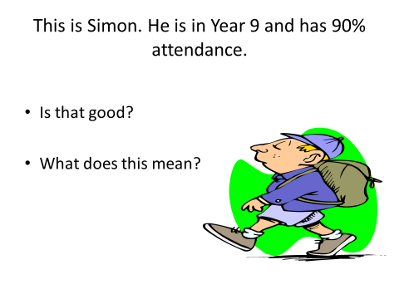

Slide 23
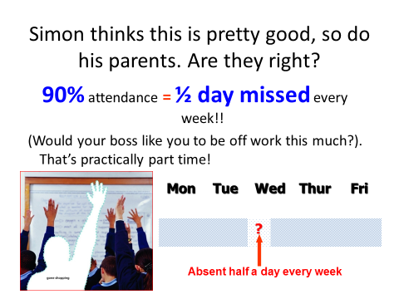

Slide 24
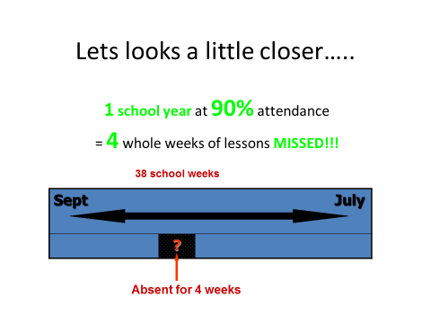

Slide 25
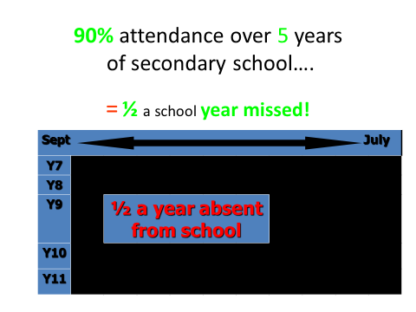

Slide 26
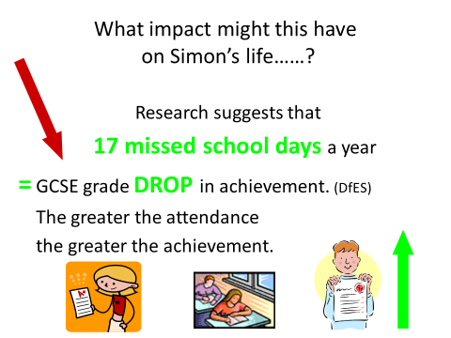

Slide 27
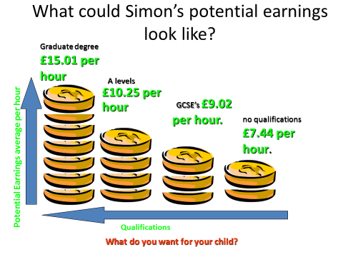

Slide 28
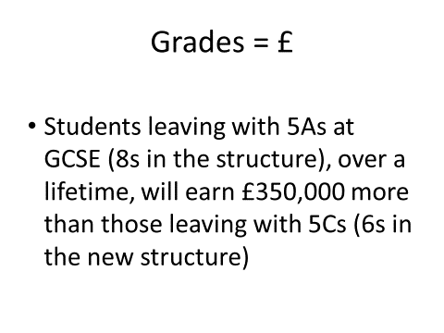

Slide 29
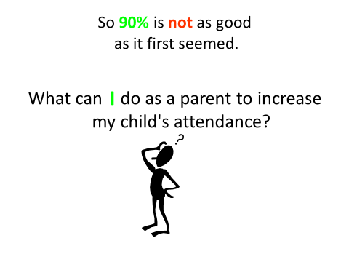

Slide 30
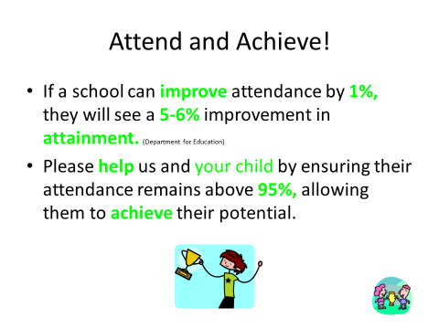

Slide 31
Making Informed Decisions
Thinking ahead 6th Form and beyond

Slide 32

Not in
Education
Employment
Training
15.6% of
16-24yr olds were NEETS in England in 2010
(Raising Participation Age)

Slide 33
KS4 into Post 16.....
It has already started....
The subjects students have chosen to study will allow them to access different courses at post-16
How students approach their GCSEs now will shape what they can do at post – 16
How the students perform at GCSE will open and close different doors

Slide 34
KS4 into Post 16.....
Options at post-16:
Attend The Langley Academy 6th Form
Attend another post-16 provider
Attend College
Apprenticeships
Employment
The students need to choose the right option for them

Slide 35

KS4 into Post 16.....
5 Level 4 and above including
English & Maths

Slide 36
KS4 into Post 16.....
Students can attend University:
Oxford/Cambridge
Russell Group
Other Universities
Engineering
Law
Medicine
Physiotherapy
Business Management
Geology
Occupational Therapy
Philosophy

Slide 37
Remember:
“Fail to prepare; prepare to fail!”
"Take action today to improve tomorrow"

